Slide 1
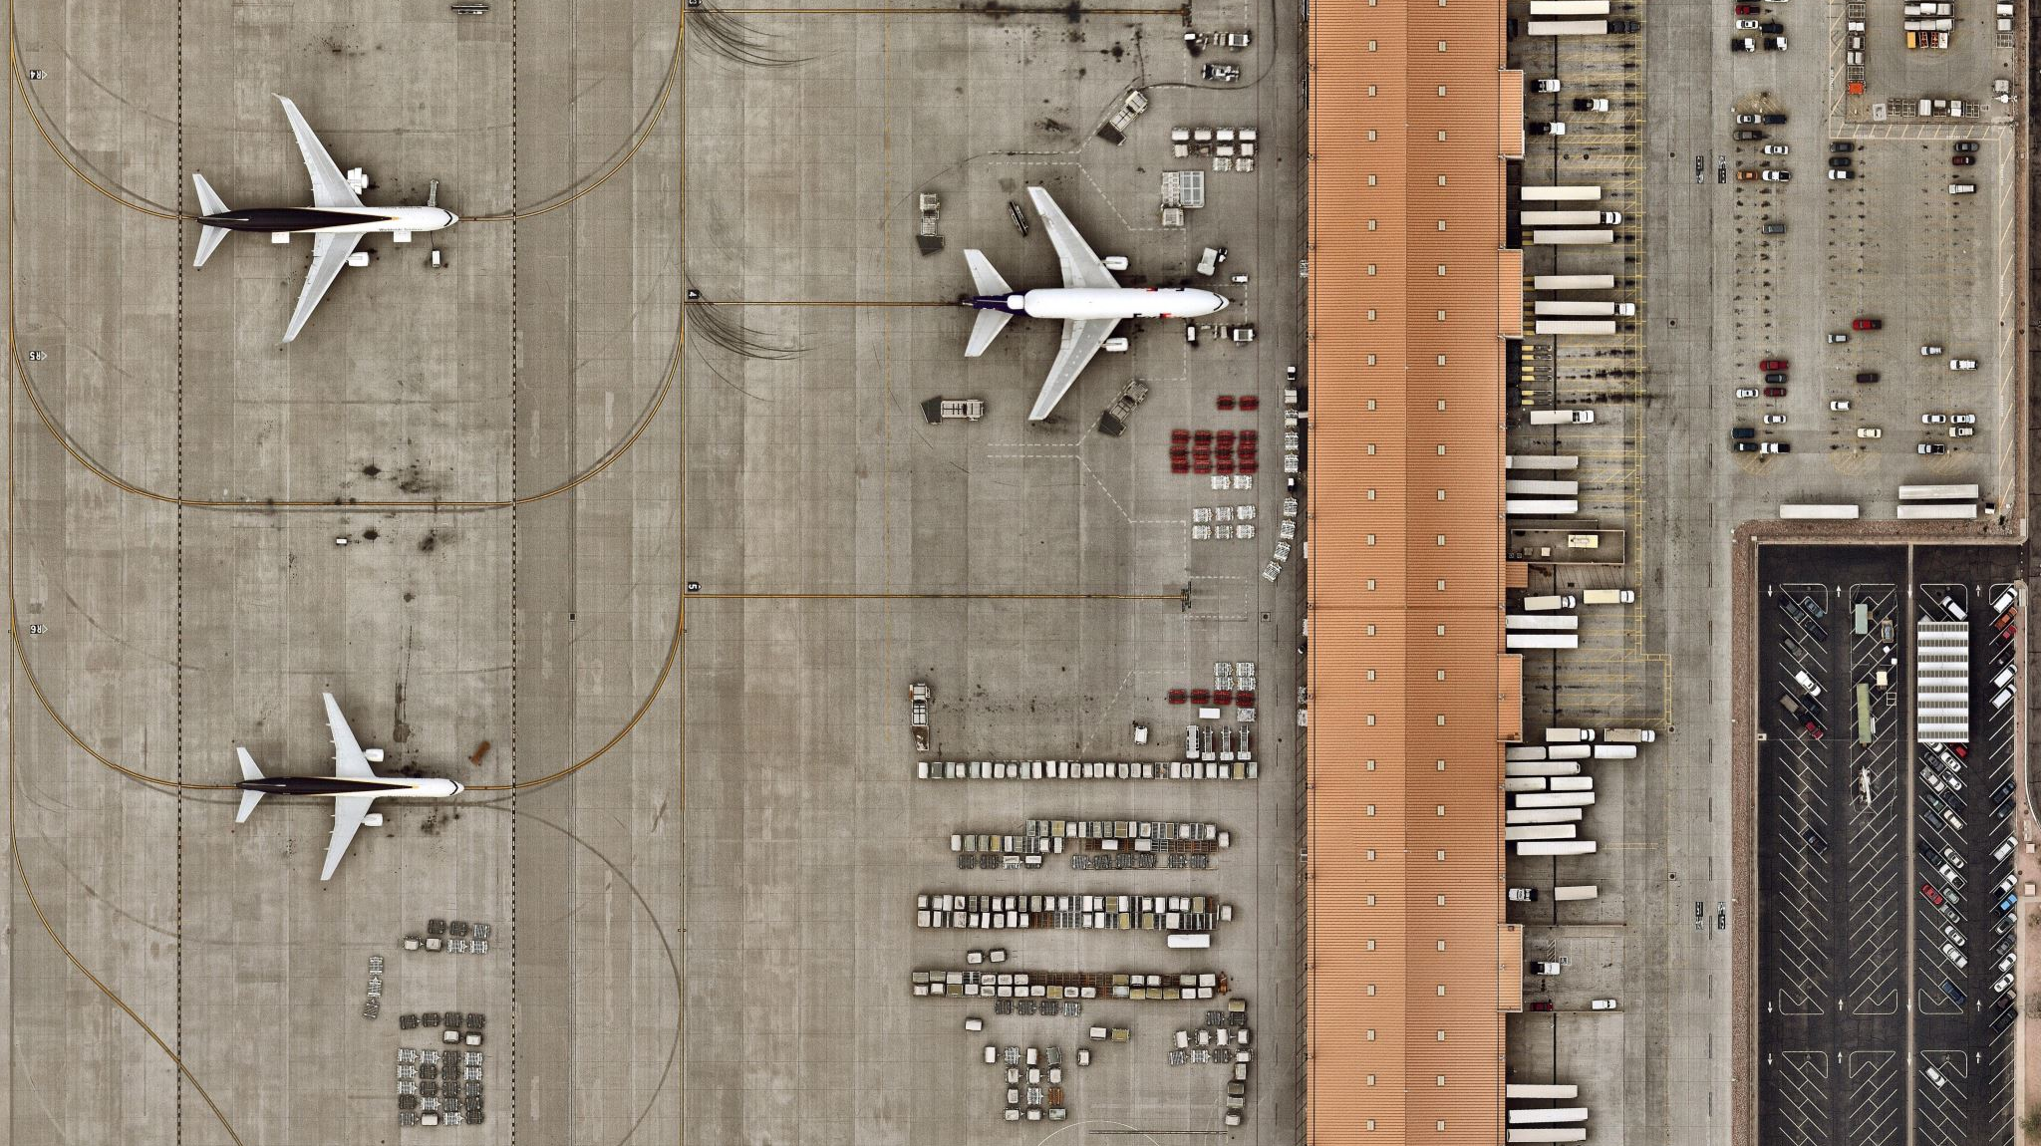
Airlines Data Visualization
Azure and PowerBI

Slide 2
Business Problem/Case Study
Let's assume that an airline company who collects the month wise data of the delay , cancelled and on time flights. And the company wants to built an end-to-end data pipeline on azure cloud to find the following insights.
Total number of flights delayed for different time periods
Total number of flights cancelled for different time periods
Total number of flights on-time for different time periods
Visualization of delayed flights by month
Visualization of cancelled flights by month
Visualization of on-time flights by month
Visualization of average departure delay by month
Visualization of average departure delay by year
Any other significant insights from the data

Slide 3
About the dataset Airlines.csv
This dataset is all about flights in the united states, including information about the number, length, and type of delays. The data is reported for individual months at every major airport for every carrier. Additional information is available: http://www.rita.dot.gov/bts/help/aviation/html/understanding.html

Slide 4
Information about the Airline Table/CSV
Key | List of... | Comment | Example Value
Airport.Code | String | The 3 letter code for this airport, assigned by IATA. For more information, consult this List of Airport Codes. | "ATL"
Airport.Name | String | The full name of this airport. | "Atlanta, GA: Hartsfield-Jackson Atlanta International"
Time.Label | String | The "year/month" reported as a string, to make it easier to sort by time periods. | "2003/06"
Time.Month | Integer | The reported month as a number. 0 is January, 1 is February, etc. | 6
Time.Month Name | String | Month name | "June"
Time.Year | Integer | The reported year as a 4-digit number. | 2003
Statistics.# of Delays.Carrier | Integer | The number of delays and cancellations due to circumstances within the airline's control (e.g. maintenance or crew problems, aircraft cleaning, baggage loading, fueling, etc.) in this month. | 1009
Statistics.# of Delays.Late Aircraft | Integer | The number of delays and cancellations caused by a previous flight with the same aircraft arriving late, causing the present flight to depart late in this month. | 1275
Statistics.# of Delays.National Aviation System | Integer | The number of delays and cancellations attributable to the national aviation system that refer to a broad set of conditions, such as non-extreme weather conditions, airport operations, heavy traffic volume, and air traffic control in this month. | 3217
Statistics.# of Delays.Security | Integer | Number of delays or cancellations caused by evacuation of a terminal or concourse, re-boarding of aircraft because of security breach, inoperative screening equipment and/or long lines in excess of 29 minutes at screening areas in this month. | 17
Statistics.# of Delays.Weather | Integer | Number of delays or cancellations caused by significant meteorological conditions (actual or forecasted) that, in the judgment of the carrier, delays or prevents the operation of a flight such as tornado, blizzard or hurricane in this month. | 328
Statistics.Carriers.Names | String | The full names of the carriers that reported in. | "American Airlines Inc.,JetBlue Airways,Continental Air Lines Inc.,Delta Air Lines Inc.,Atlantic Southeast Airlines,AirTran Airways Corporation,America West Airlines Inc.,Northwest Airlines Inc.,ExpressJet Airlines Inc.,United Air Lines Inc.,US Airways Inc."
Statistics.Carriers.Total | Integer | The number of carriers that reported flight information during this time period and at this location. | 11
Statistics.Flights.Cancelled | Integer | The number of flights that were cancelled in this month. | 216
Statistics.Flights.Delayed | Integer | The number of flights that were delayed in this month. | 5843
Statistics.Flights.Diverted | Integer | The number of flights that were diverted in this month. | 27
Statistics.Flights.On Time | Integer | The number of flights that were on time in this month. | 23974
Statistics.Flights.Total | Integer | The total number of flights in this month. | 30060
Statistics.Minutes Delayed.Carrier | Integer | The number of minutes delayed due to circumstances within the airline's control (e.g. maintenance or crew problems, aircraft cleaning, baggage loading, fueling, etc.) in this month. | 61606
Statistics.Minutes Delayed.Late Aircraft | Integer | The number of minutes delayed caused by a previous flight with the same aircraft arriving late, causing the present flight to depart late in this month. | 68335
Statistics.Minutes Delayed.National Aviation System | Integer | The number of minutes delayed attributable to the national aviation system that refer to a broad set of conditions, such as non-extreme weather conditions, airport operations, heavy traffic volume, and air traffic control in this month. | 118831
Statistics.Minutes Delayed.Security | Integer | Number of minutes delayed caused by evacuation of a terminal or concourse, re-boarding of aircraft because of security breach, inoperative screening equipment and/or long lines in excess of 29 minutes at screening areas in this month. | 518
Statistics.Minutes Delayed.Total | Integer | $MISSING_FIELD | 268764
Statistics.Minutes Delayed.Weather | Integer | Number of of minutes delayed caused by significant meteorological conditions (actual or forecasted) that, in the judgment of the carrier, delays or prevents the operation of a flight such as tornado, blizzard or hurricane in this month. | 19474

Slide 5
High-level Solution plan using Azure
We will make data pipeline using Azure Data Factory.
Let’s compare the scenario with a real-life example.
Let's assume we have a cabinet which we want to move from a shop to Home. what necessary things we will be needed?
First, we will need a key and address to that shop
The disassembly information of the cabinet
Delivery details
The Assembly Info of the cabinet
And finally, the key and address of the home
A delivery man and a delivery manager

Slide 6
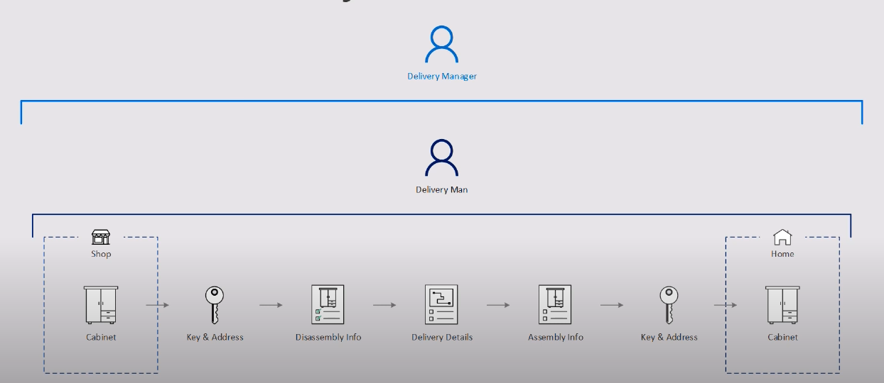
Architecture Diagram Of the real-life example

Slide 7
Let's compare the same process in Azure cloud
We will replace the shop with a blop storage and the cabinet with a csv file
This is essentially we wanted this csv file to store at some place
The key and address with a Linked Service
This is the definition to connectivity to that blop storage and authorization like a key
The Disassembly info with a dataset
This is the information of what kind of data we are puling from the blop storage or Airline.csv
The delivery details with copy activity
Everything in Data factory is an activity so the copy activity will move the data from one place to another
The assembly info with another dataset
Another Dataset will help the pipline to know that how is the customer table is structured so we can input the data there
The key and address with another Linked Service
The linked service will connect us to Airlines table in the SQL server
And finally, home will become a SQL server in which the cabinet will be replaced by the Airlines Table
we need to know where to move the data, so we need a SQL Server into Airlines Table
The delivery man will be the Integration Runtime
The Azure Data Factory will be the delivery Manager

Slide 8
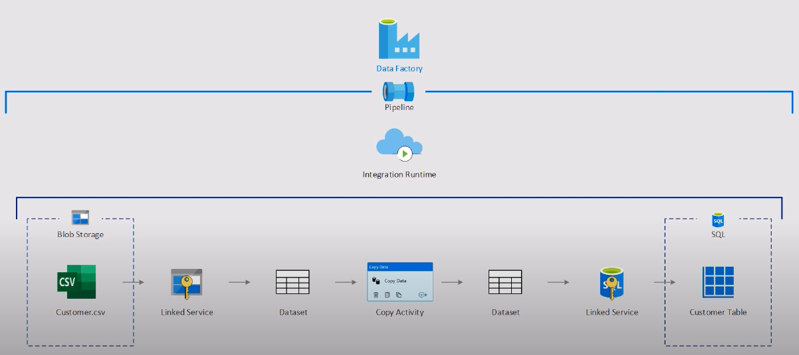
Architecture Diagram of the Actual Solution
Airline.csv
Airlines Table

Slide 9
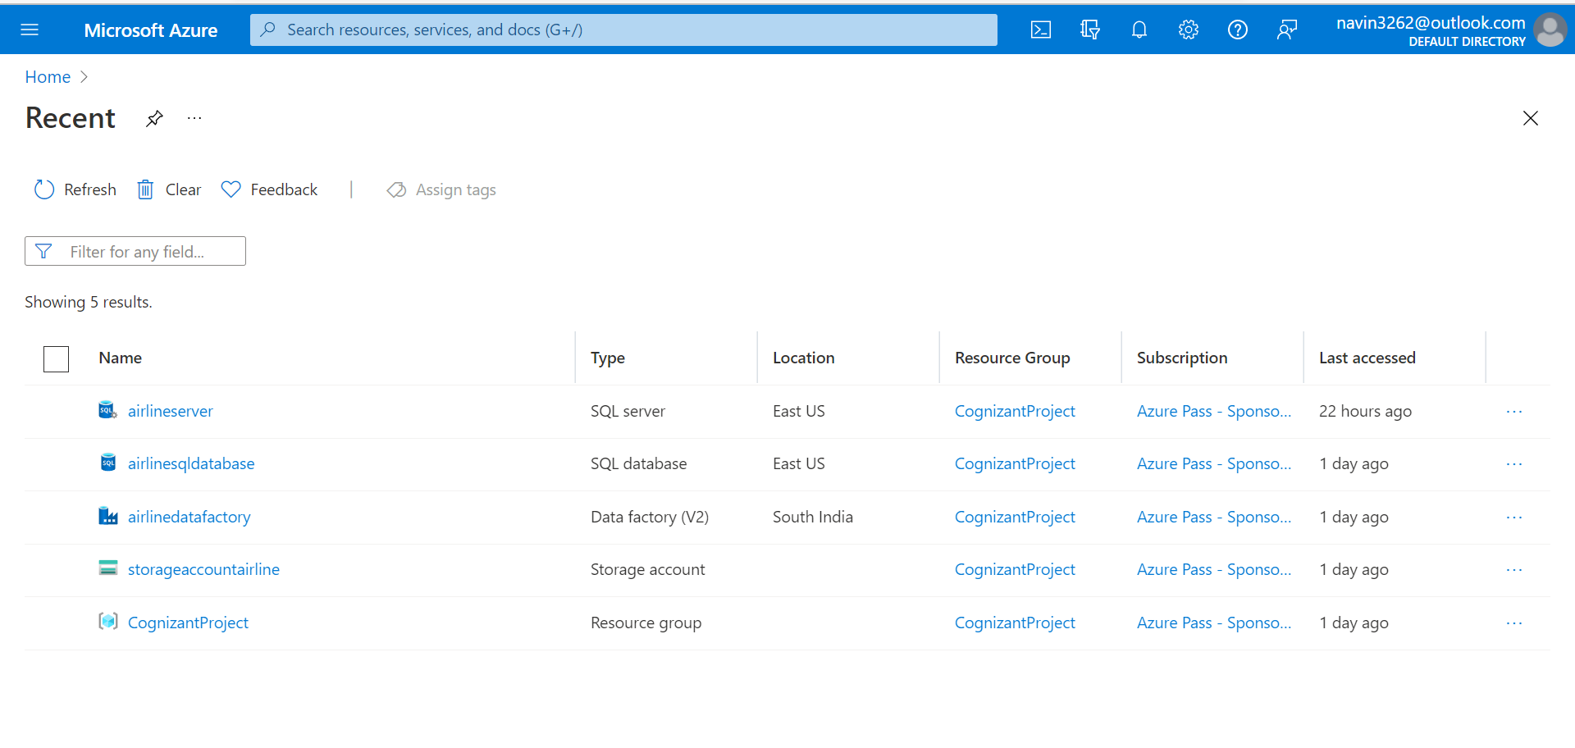
Configuration screenshots
For our project we will have the following Azure Services

Slide 10
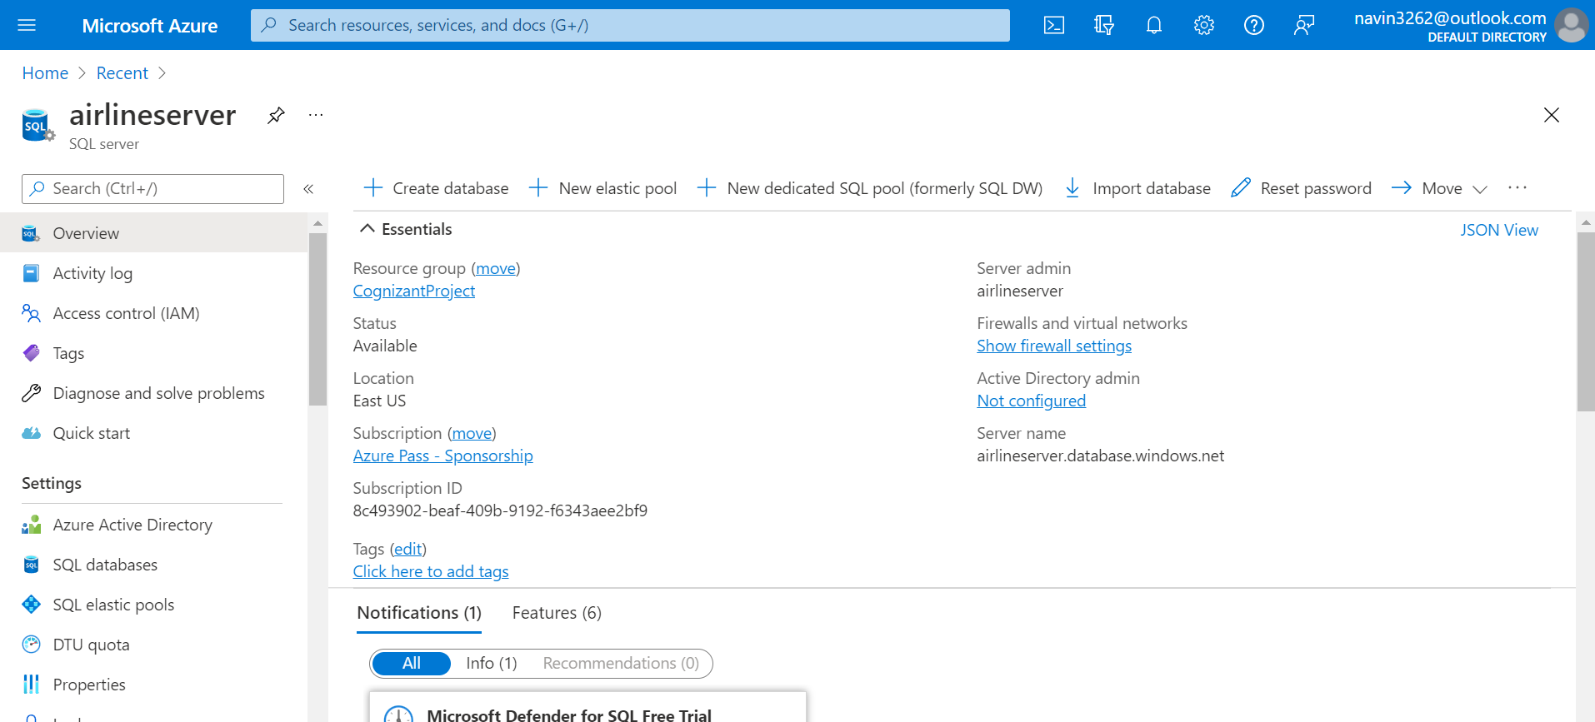
SQL server

Slide 11
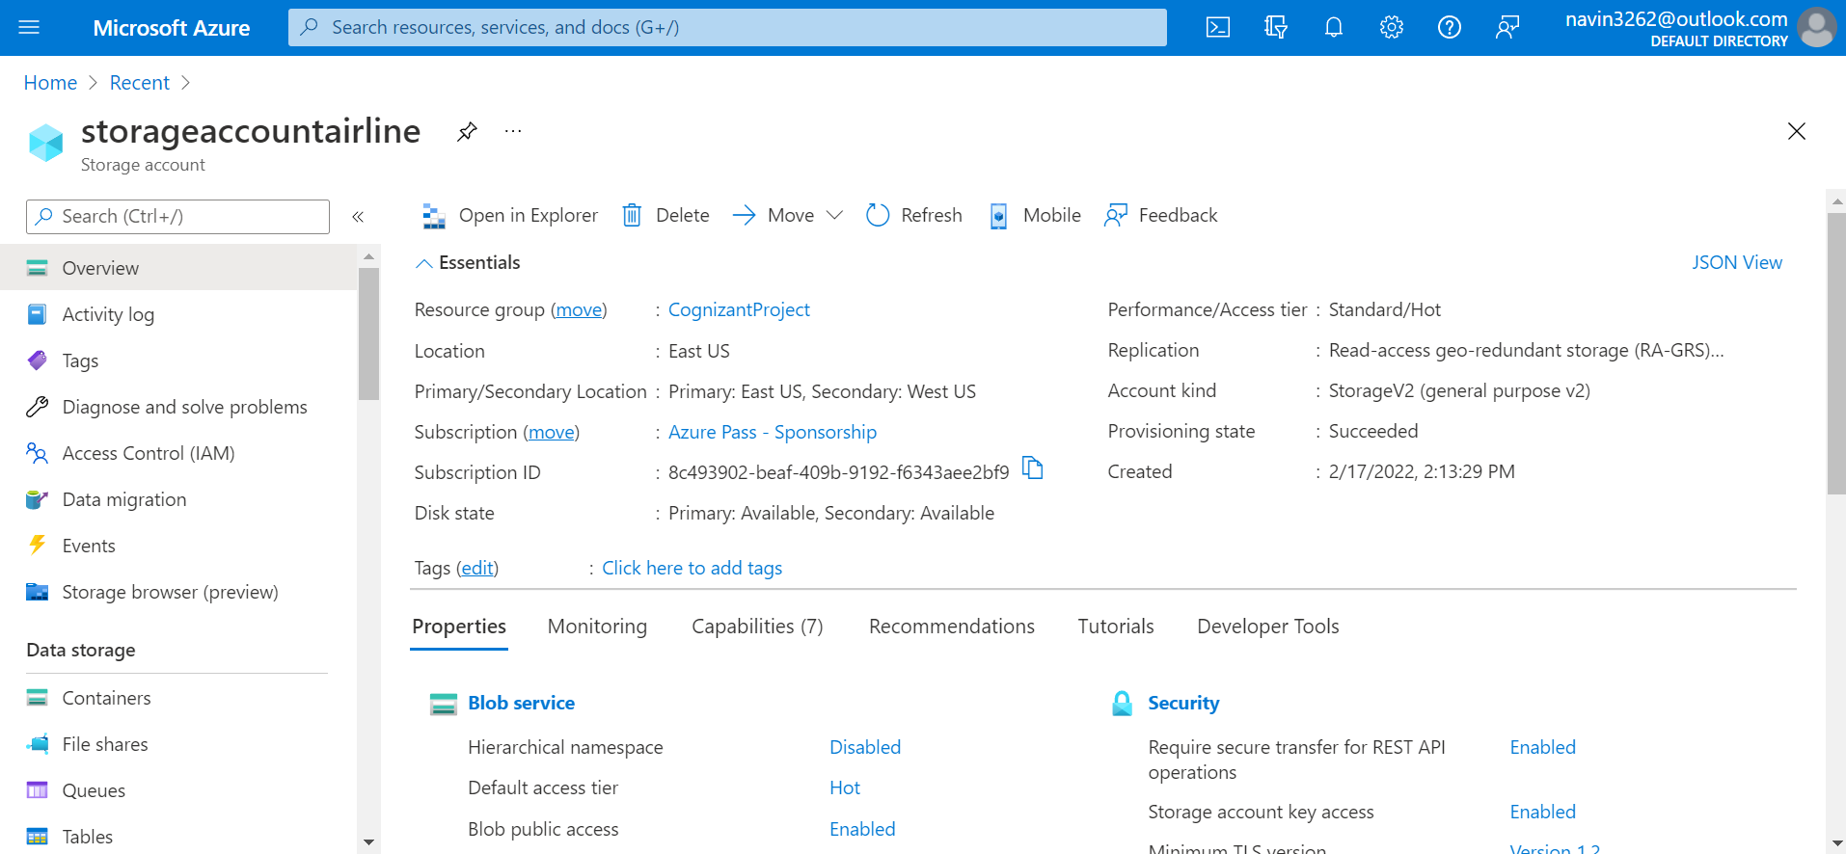
Storage Account

Slide 12
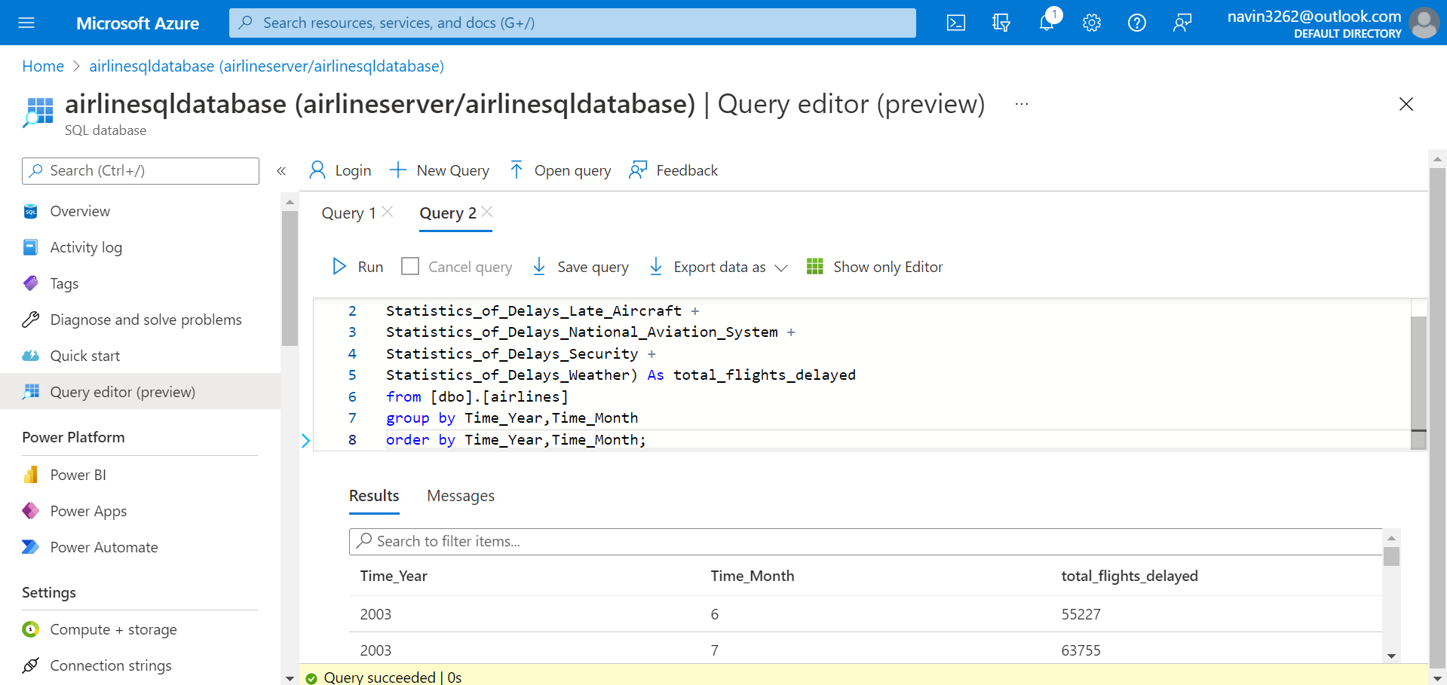
SQL Database

Slide 13
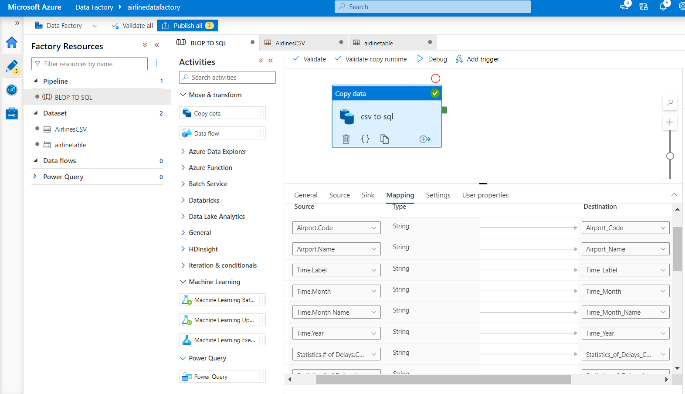
Data Factory

Slide 14
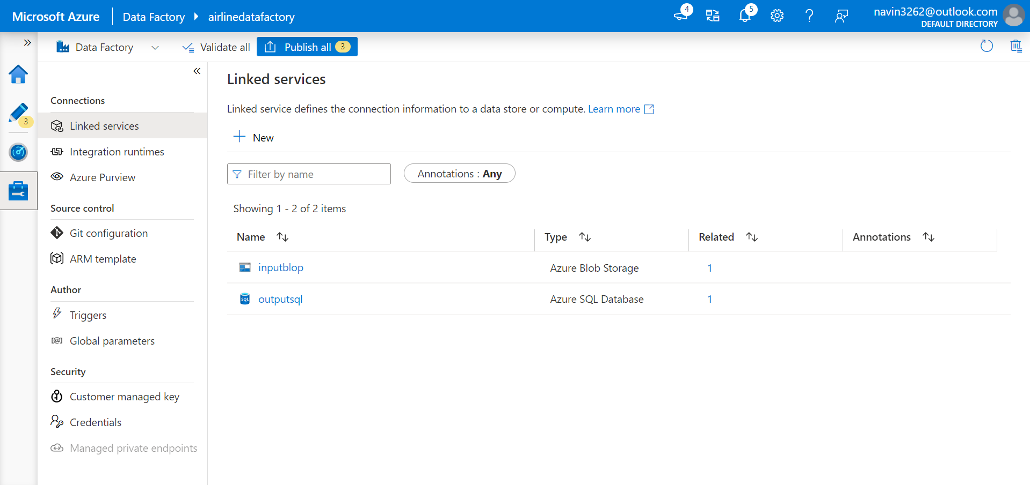
Linked Services

Slide 15
Code Snippets
For the solution of the business requirements, we will need a SQL query editor. This a very good option provided by MS azure SQL Database. following queries, we will run to get the solutions.

Slide 16
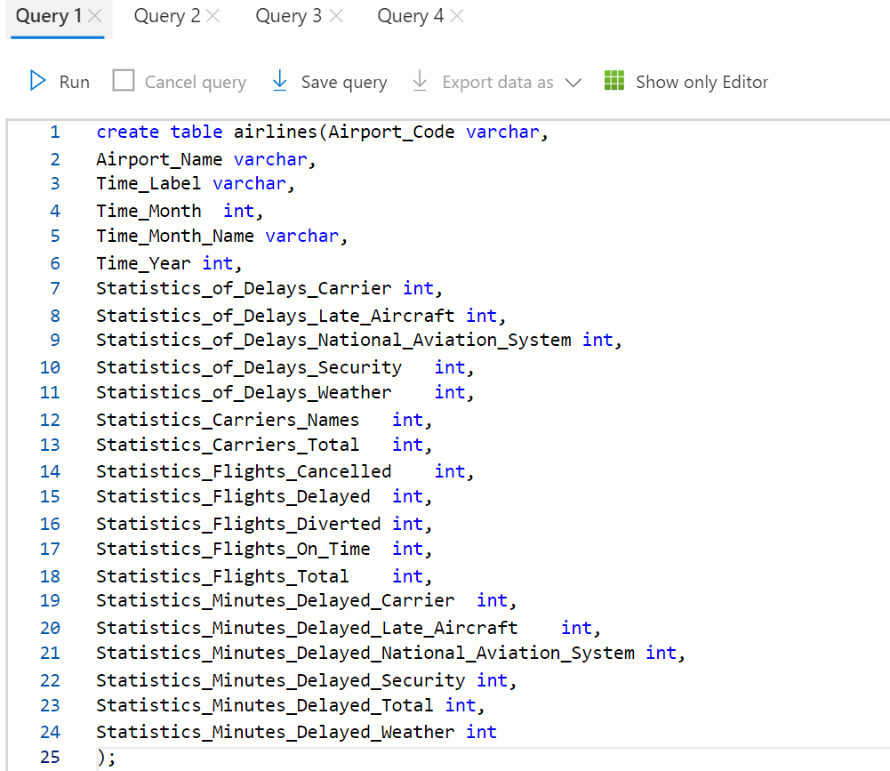
Create Airline table in the SQL database

Slide 17
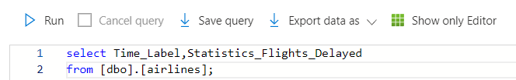
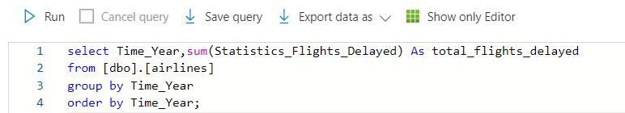
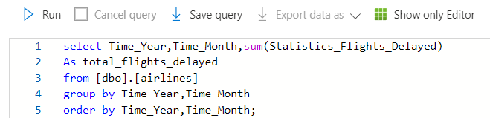
Total number of flights delayed for different time periods
1. Total number of flights delayed for each month.
All the outputs are in the from of CSV/Excel file which is there in this link
2. Total number of flights delayed year wise.
3. Total number of flights delayed month wise.
https://cognizantonline-my.sharepoint.com/:f:/r/personal/2069970_cognizant_com/Documents/airline%20csv%20output?csf=1&web=1&e=ozAqx4

Slide 18
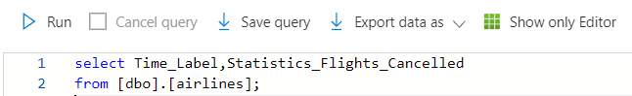
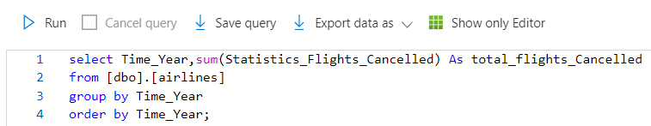
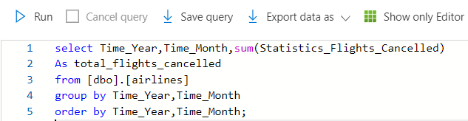
Total number of flights cancelled for different time periods
1. Total number of flights cancelled for each month.
2. Total number of flights cancelled year wise.
3. Total number of flights cancelled month wise.

Slide 19
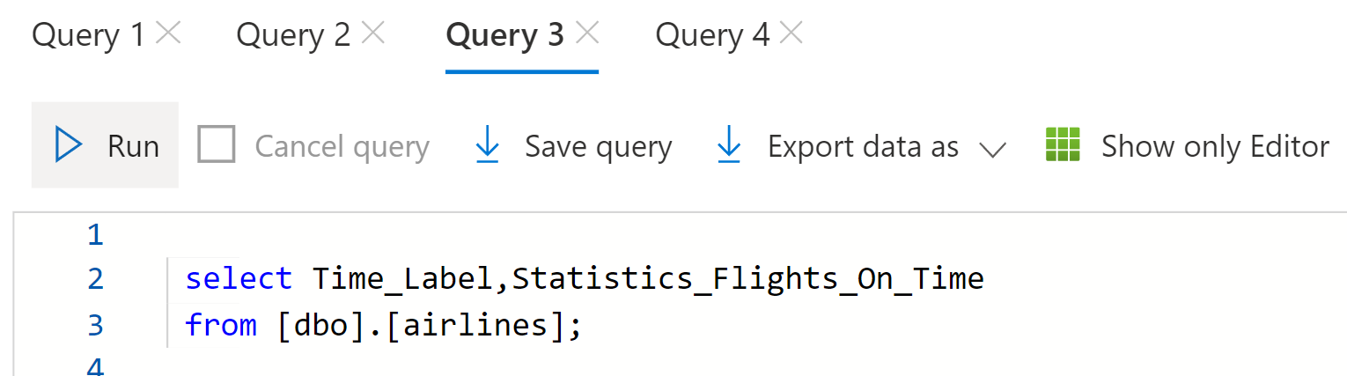
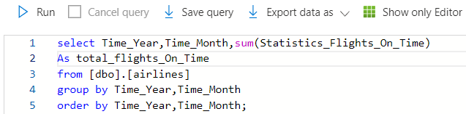
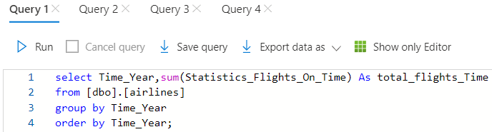
Total number of flights On Time for different time periods
1. Total number of flights On Time for each month.
2. Total number of flights On Time month wise.
3. Total number of flights On Time year wise.

Slide 20
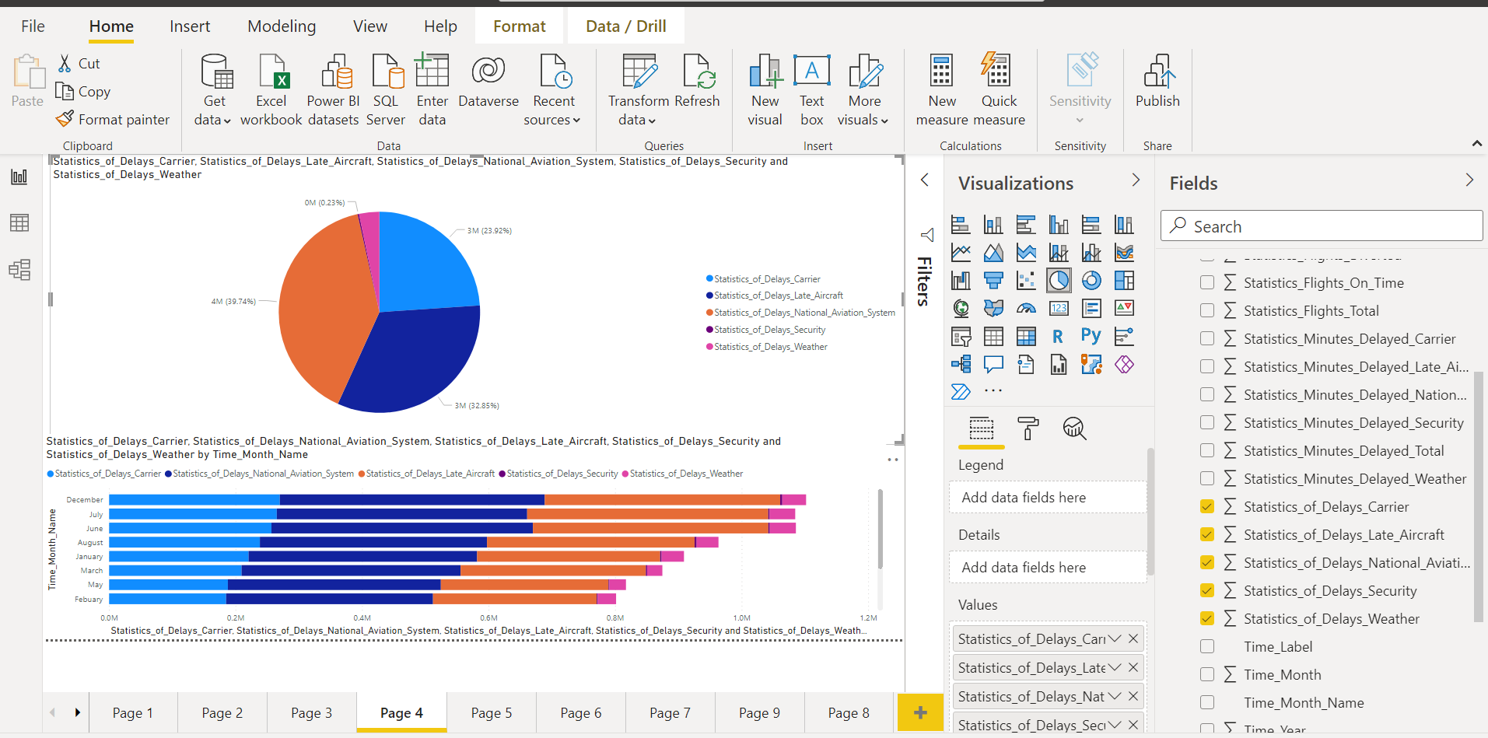
Solutions and Insights
For the solution and analysis through visuals we will use another great feature of MS Azure that is MS Power BI

Slide 21
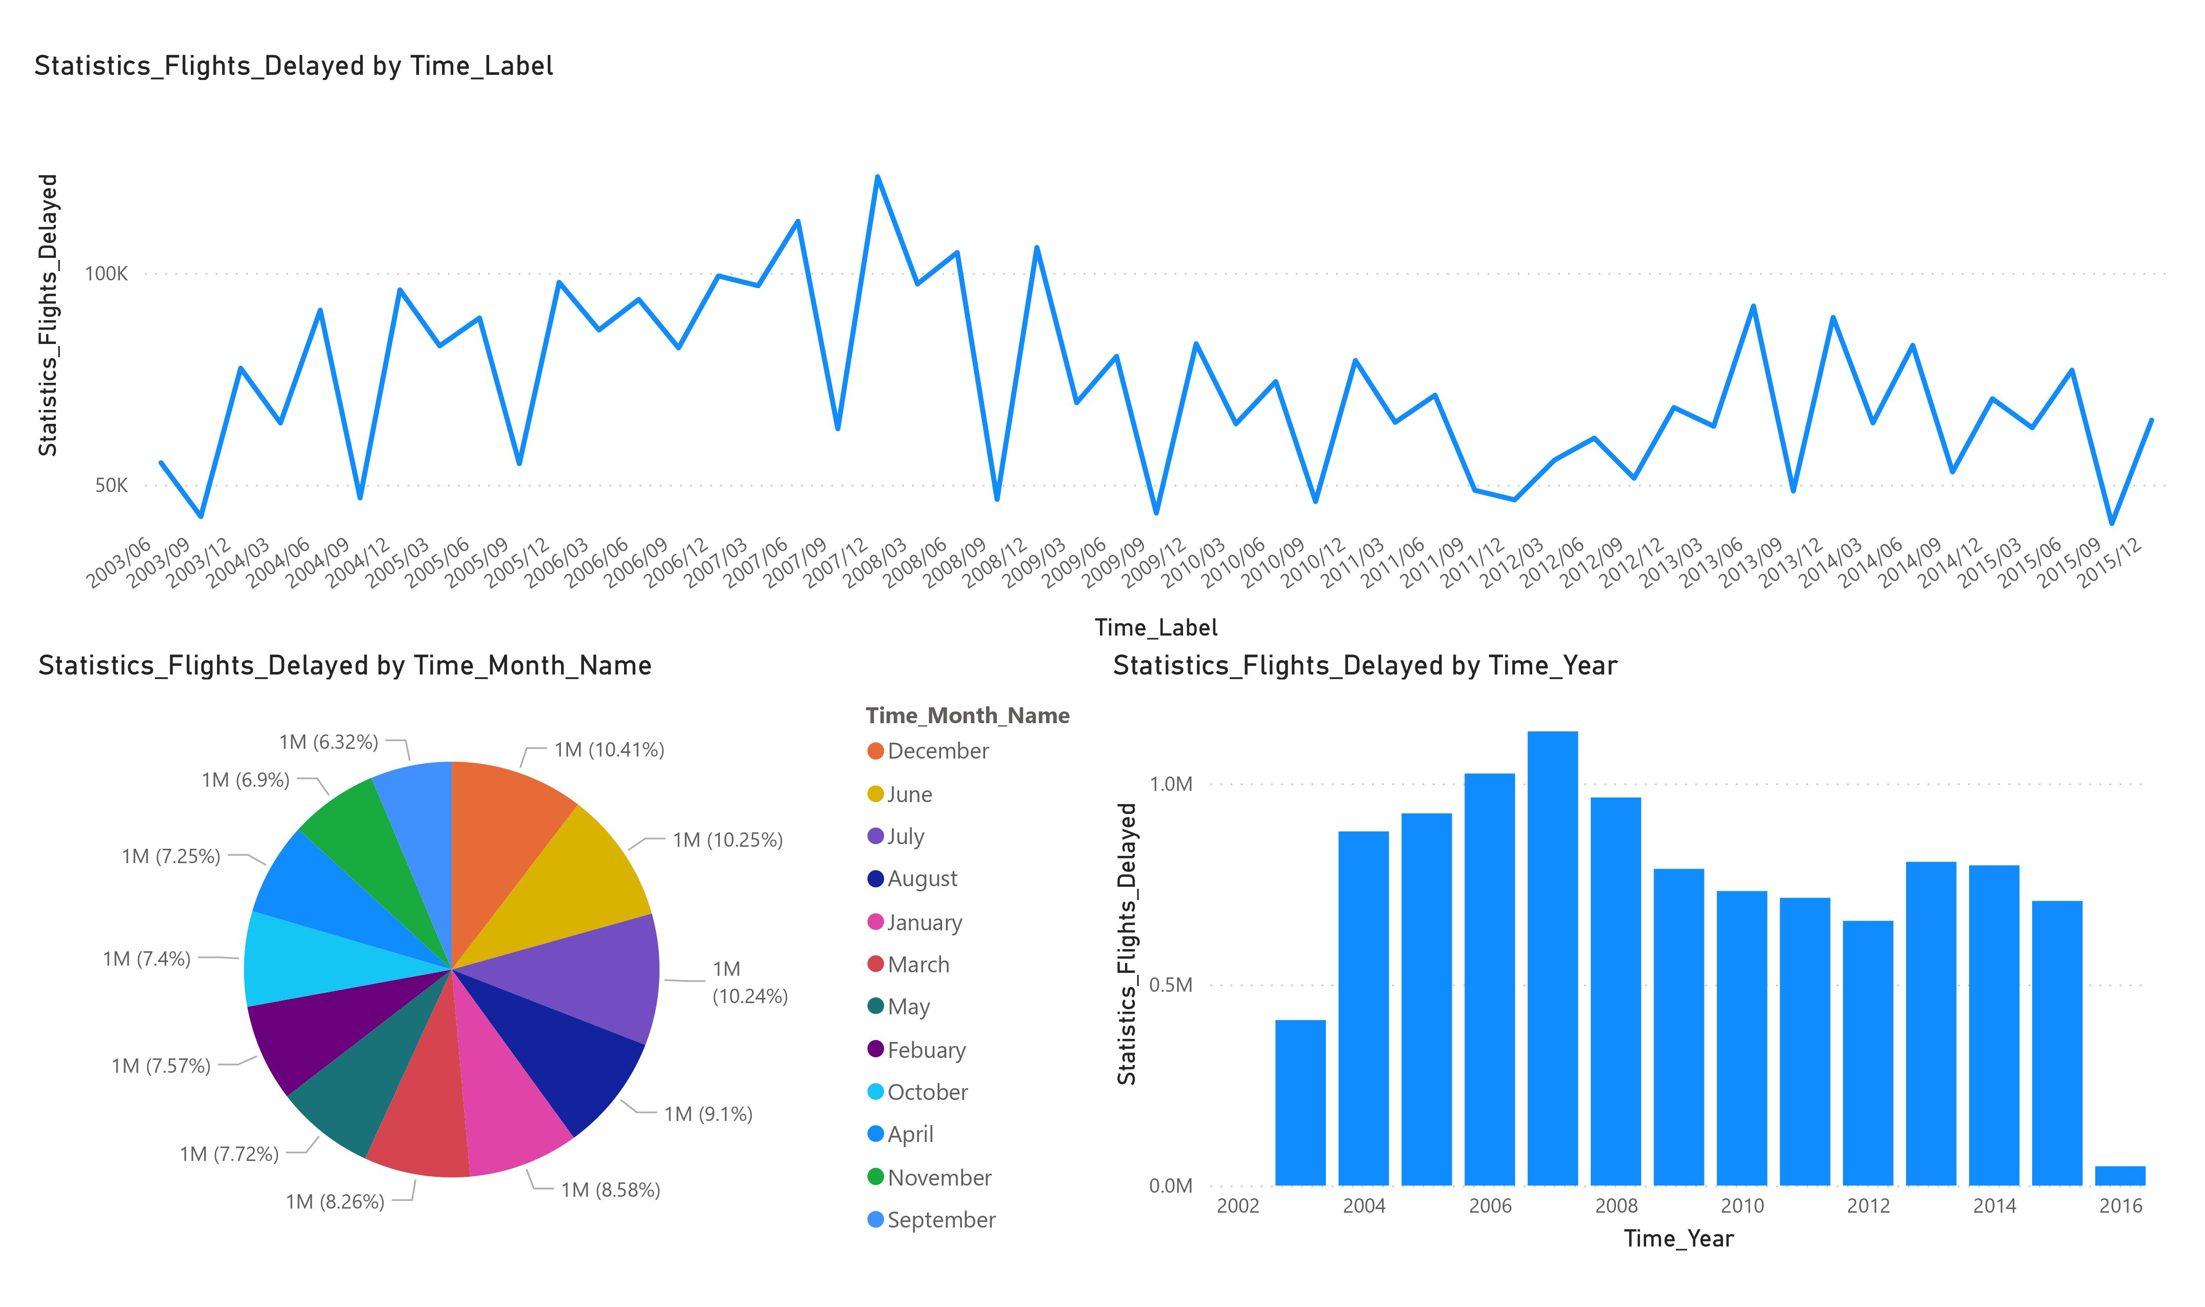
Total number of flights delayed for different time periods

Slide 22
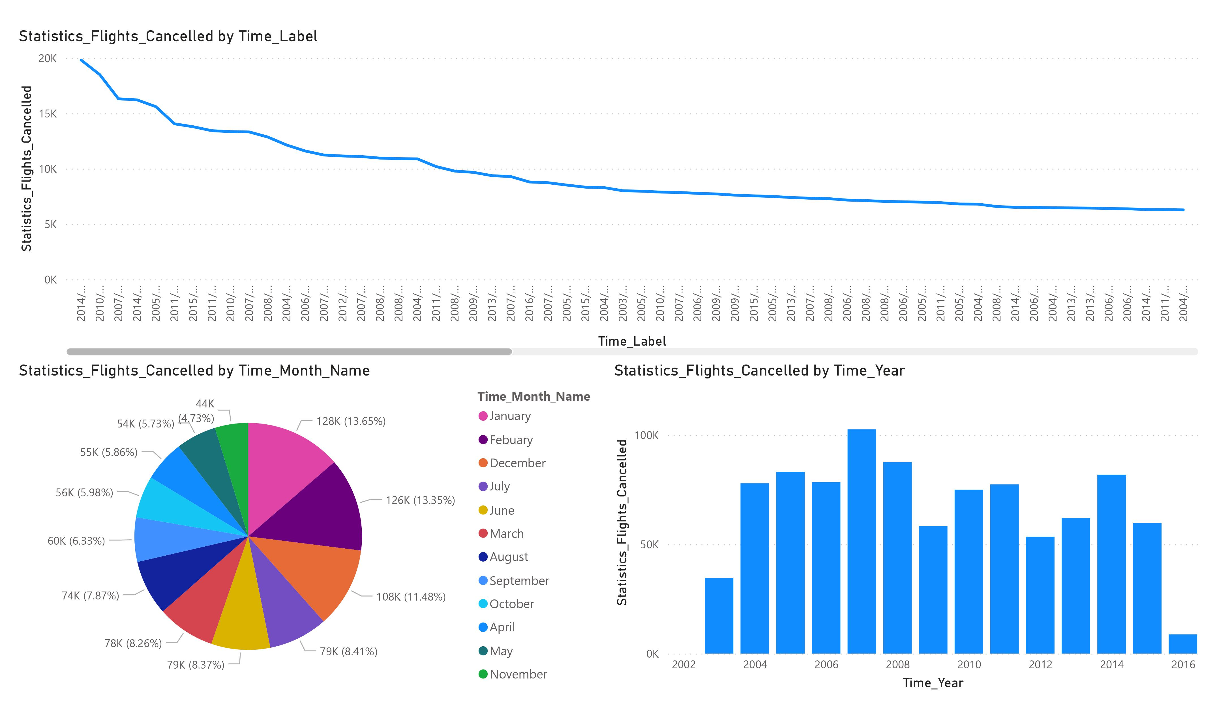
Total number of flights cancelled for different time periods

Slide 23
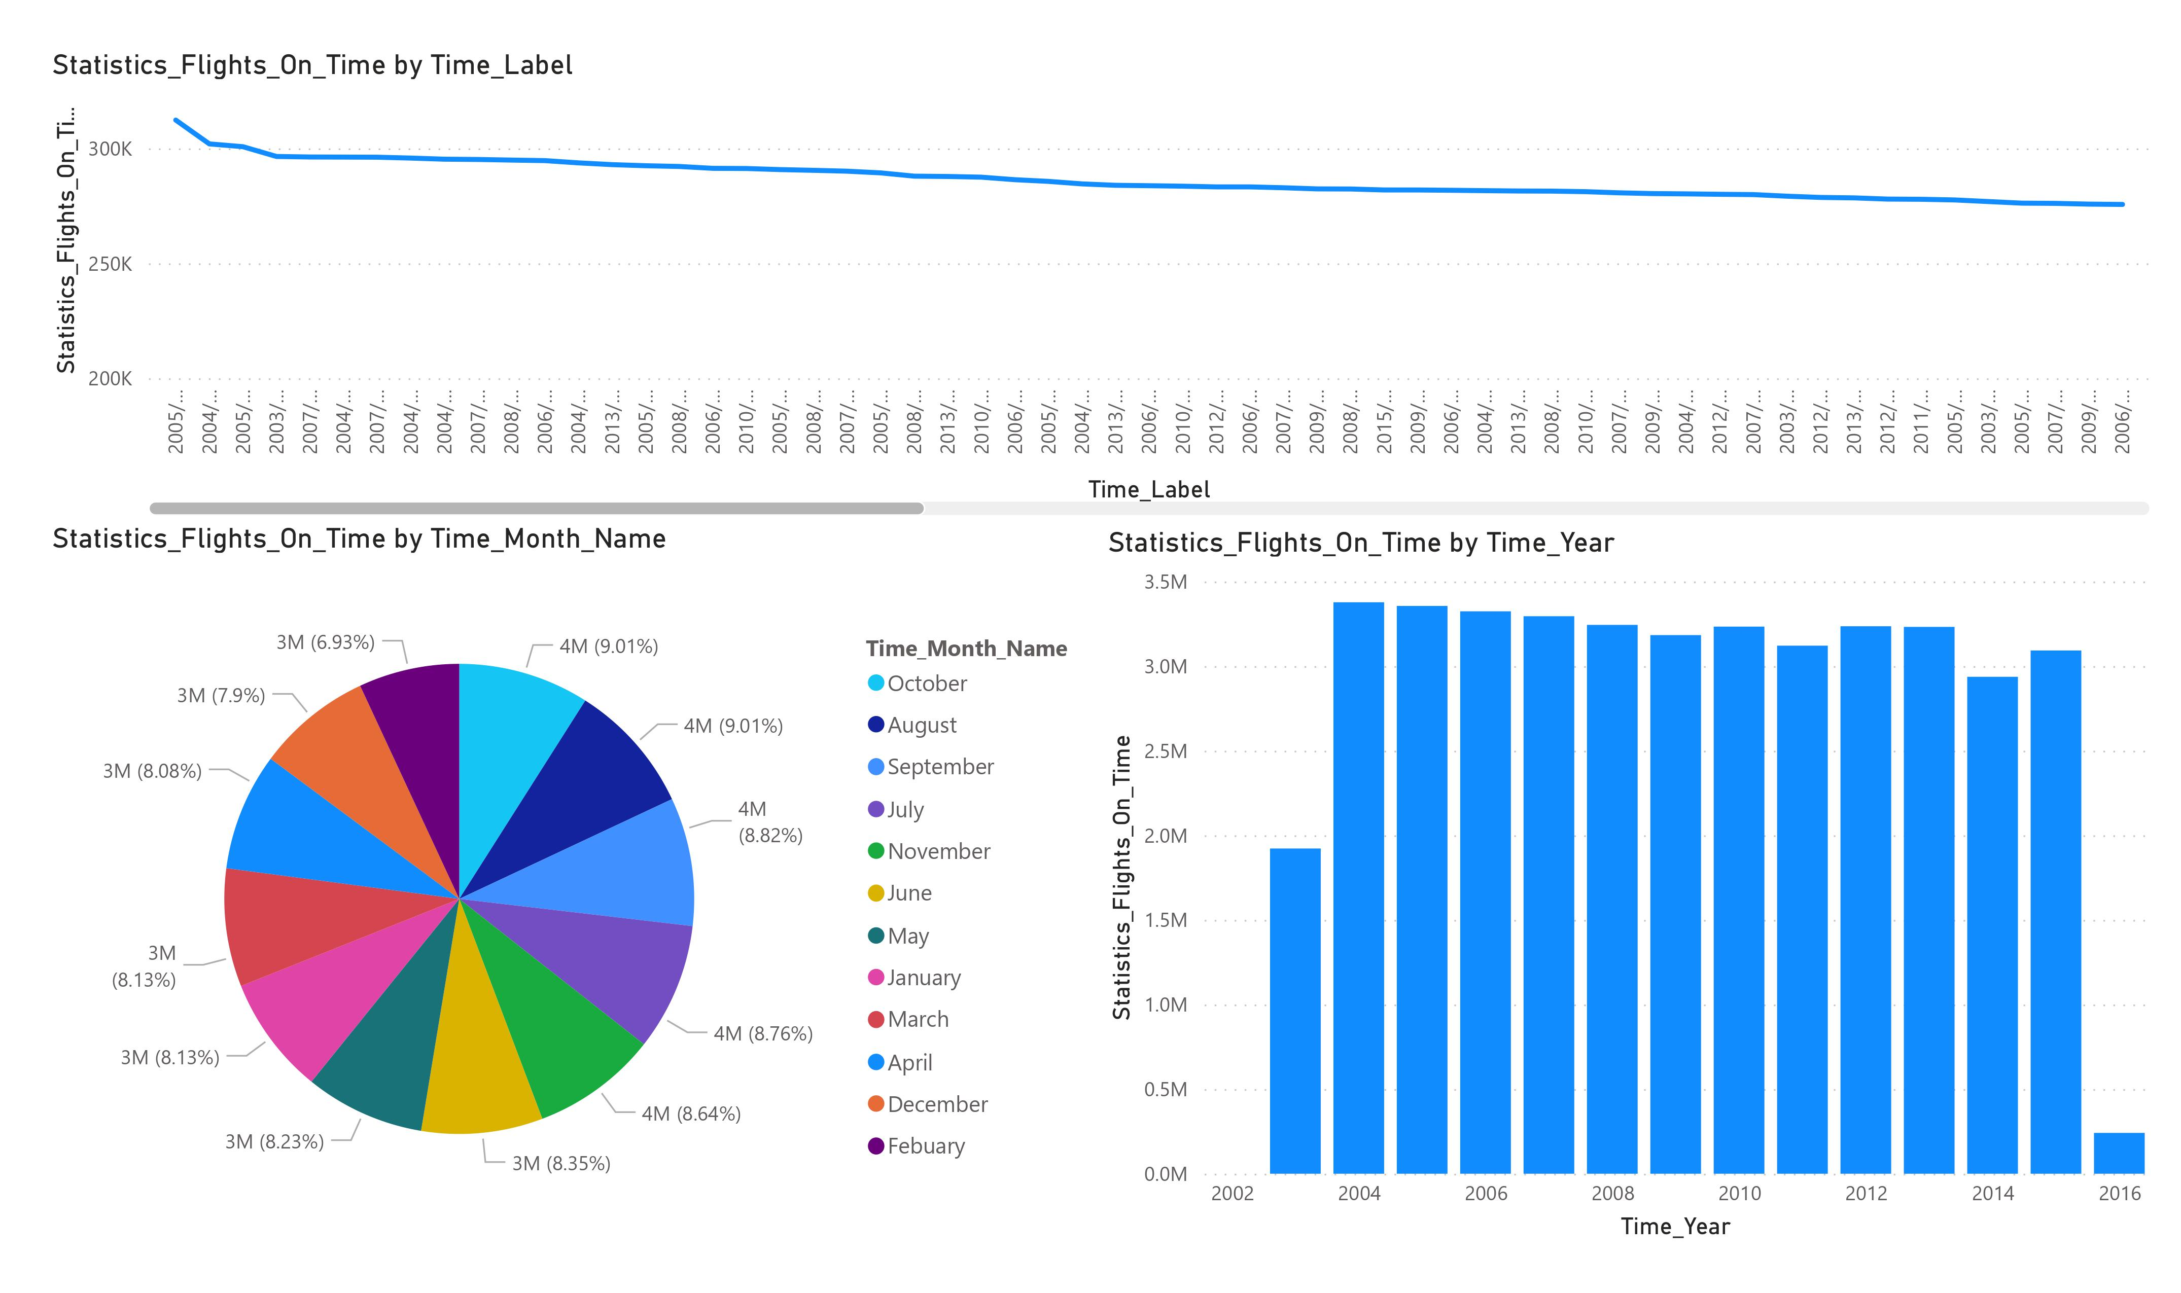
Total number of flights On Time for different time periods

Slide 24
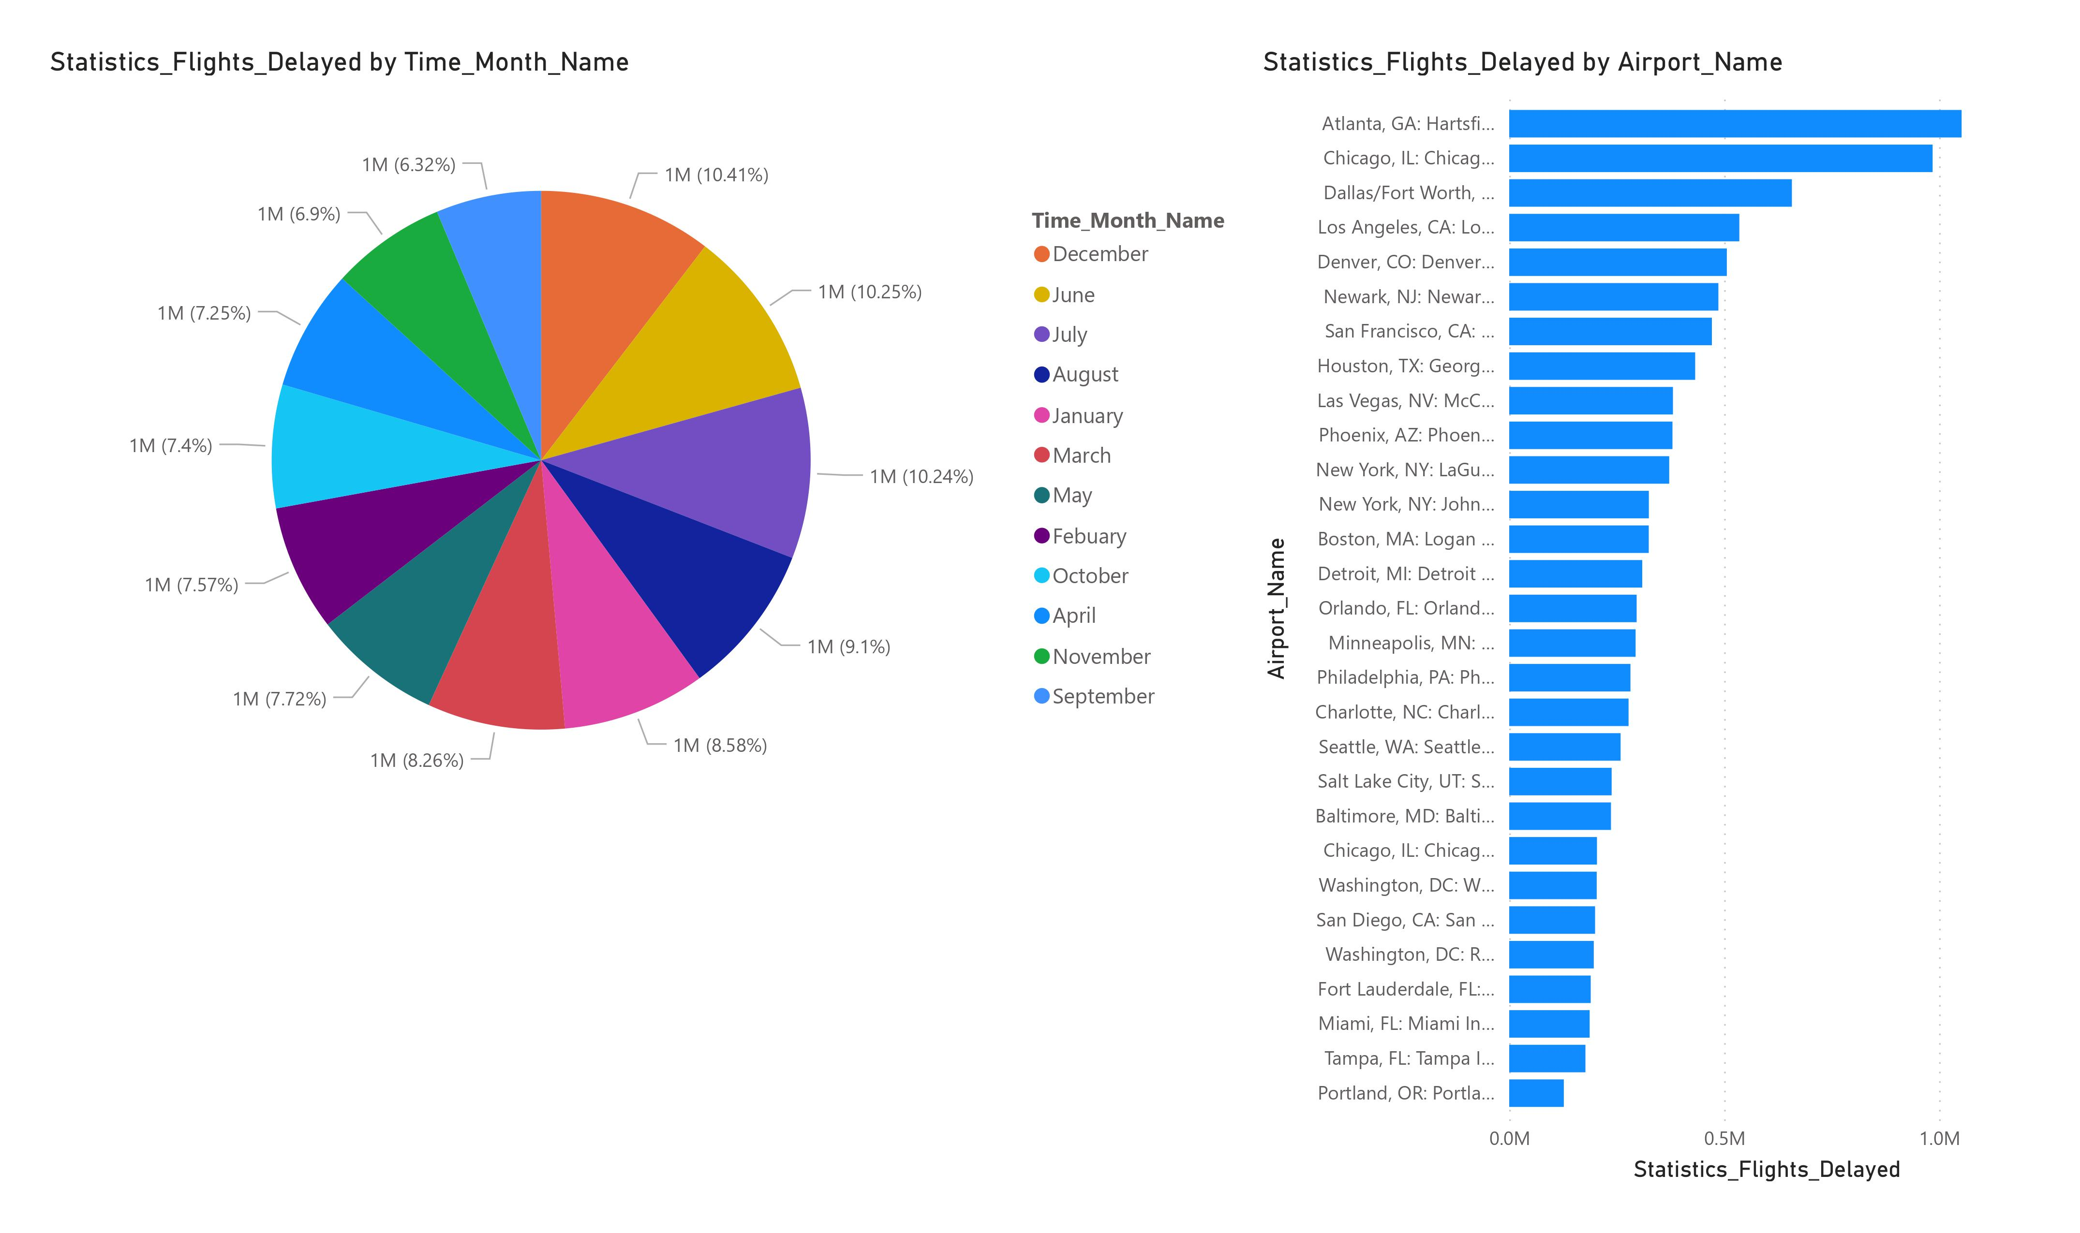
Visualization of delayed flights by month

Slide 25
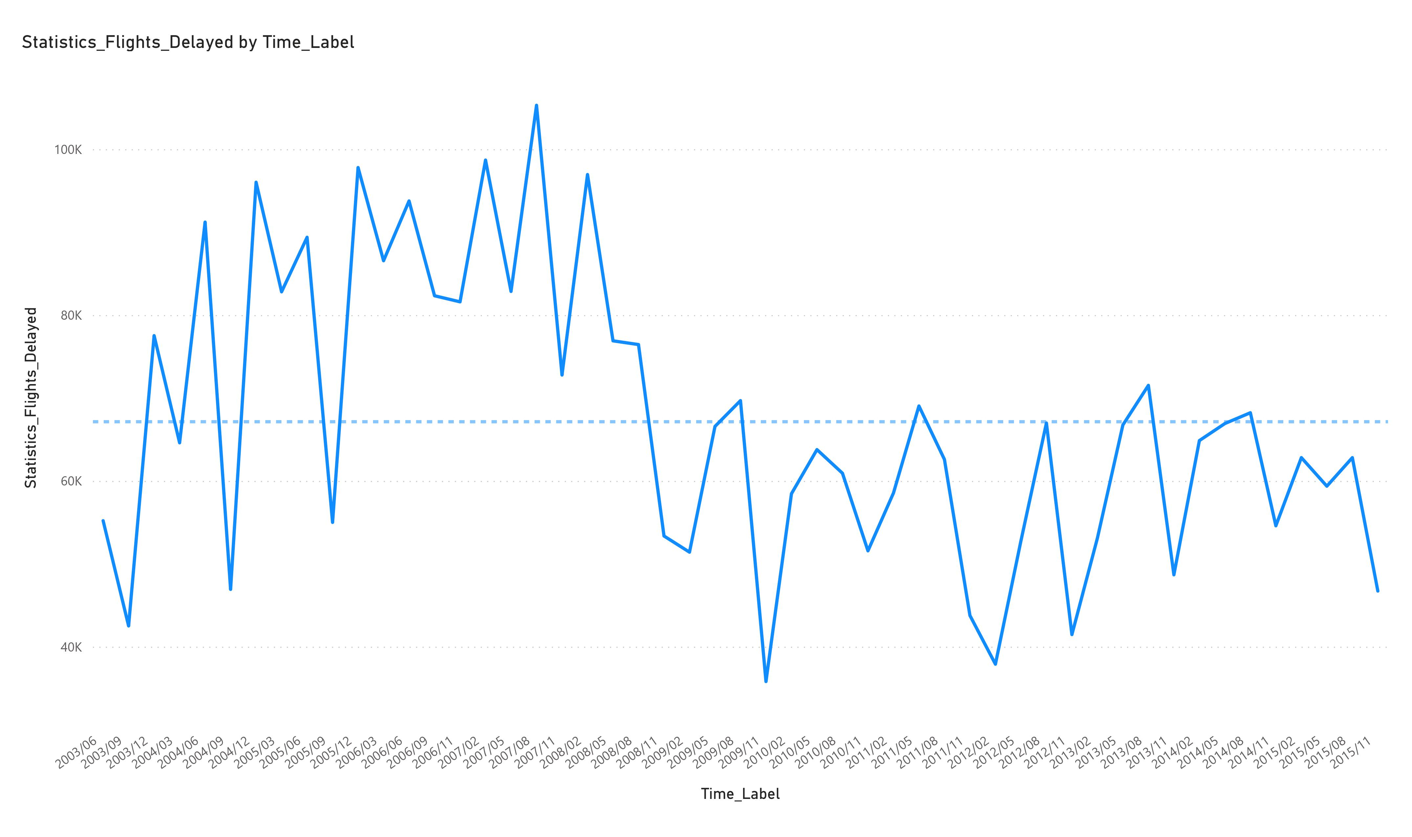
Visualization of delayed flight by month over the year

Slide 26
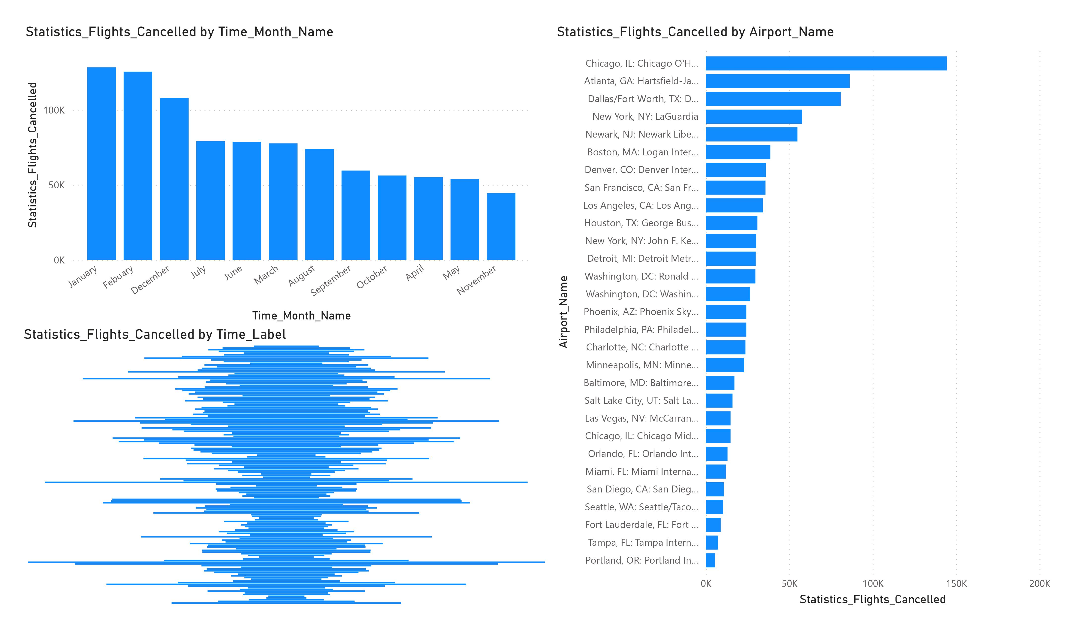
Visualization of cancelled flights by month Visualization of cancelled flights by month over years

Slide 27
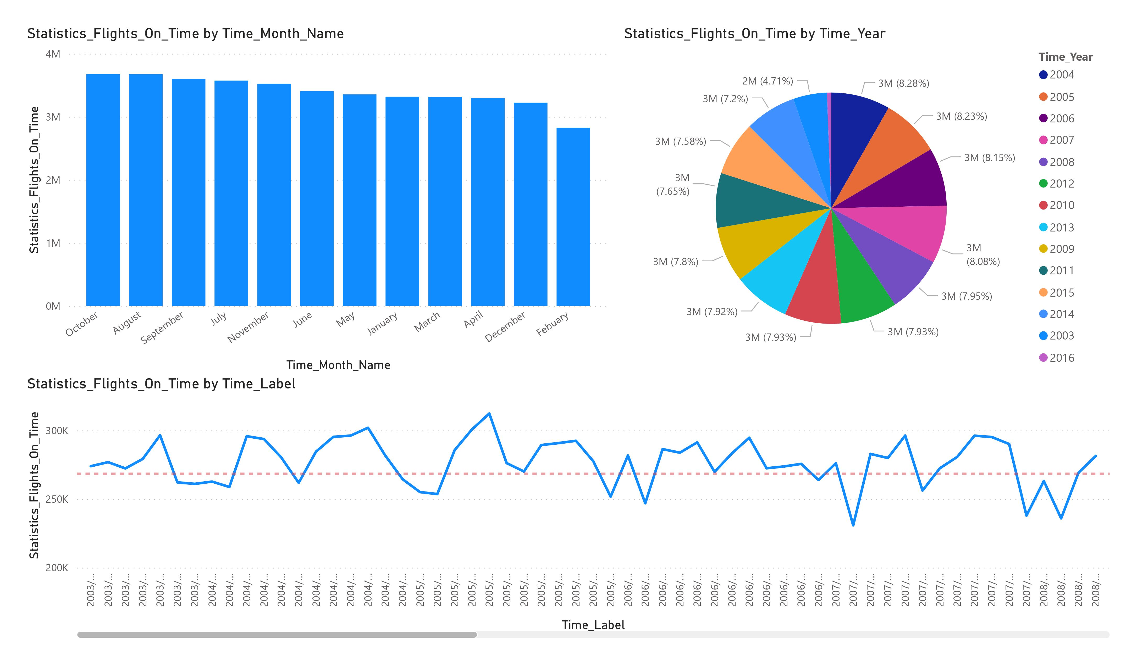
Visualization of On Time flights by month

Slide 28
Visualization of On Time flights by year and On Time flights by month throughout years

Slide 29
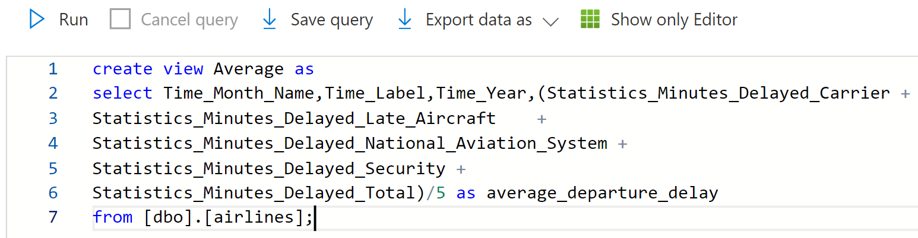
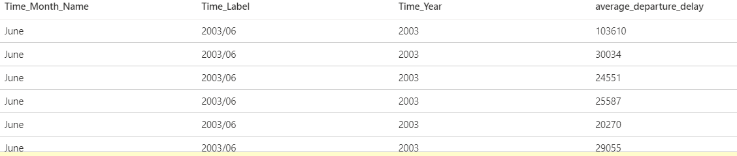
For the Visualization of average departure delay a View/Virtual Table is best option which contains the average of all the minutes delayed and corresponding month and year
Query of view as Average
Demo Table of view

Slide 30
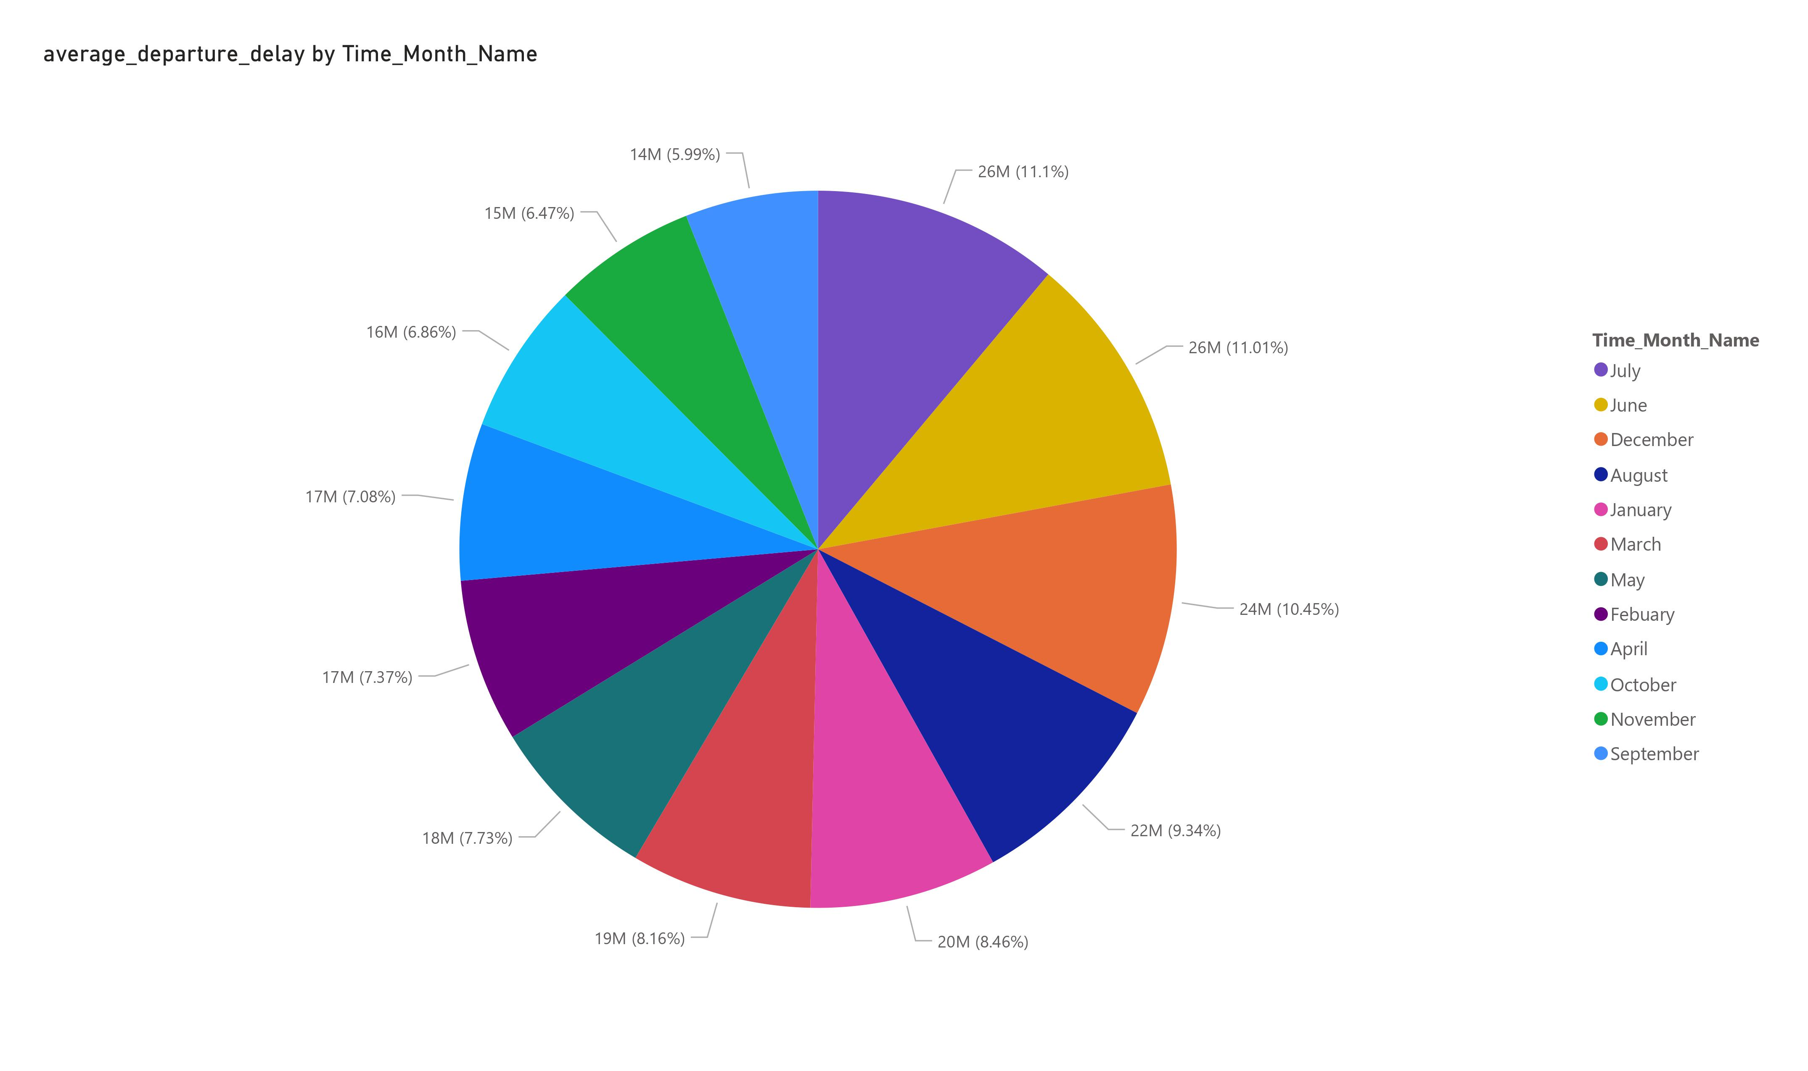
Visualization of average departure delay by month

Slide 31
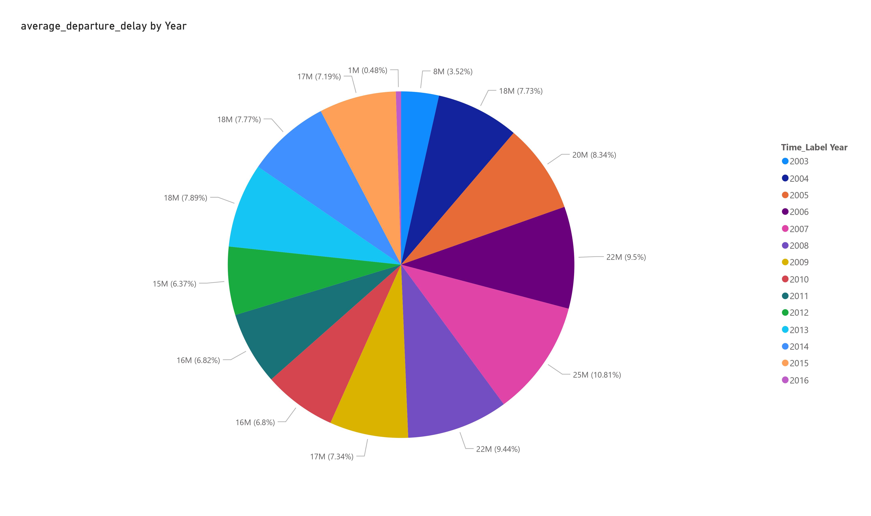
Visualization of average departure delay by year

Slide 32

Other significant insights from the data

Slide 33
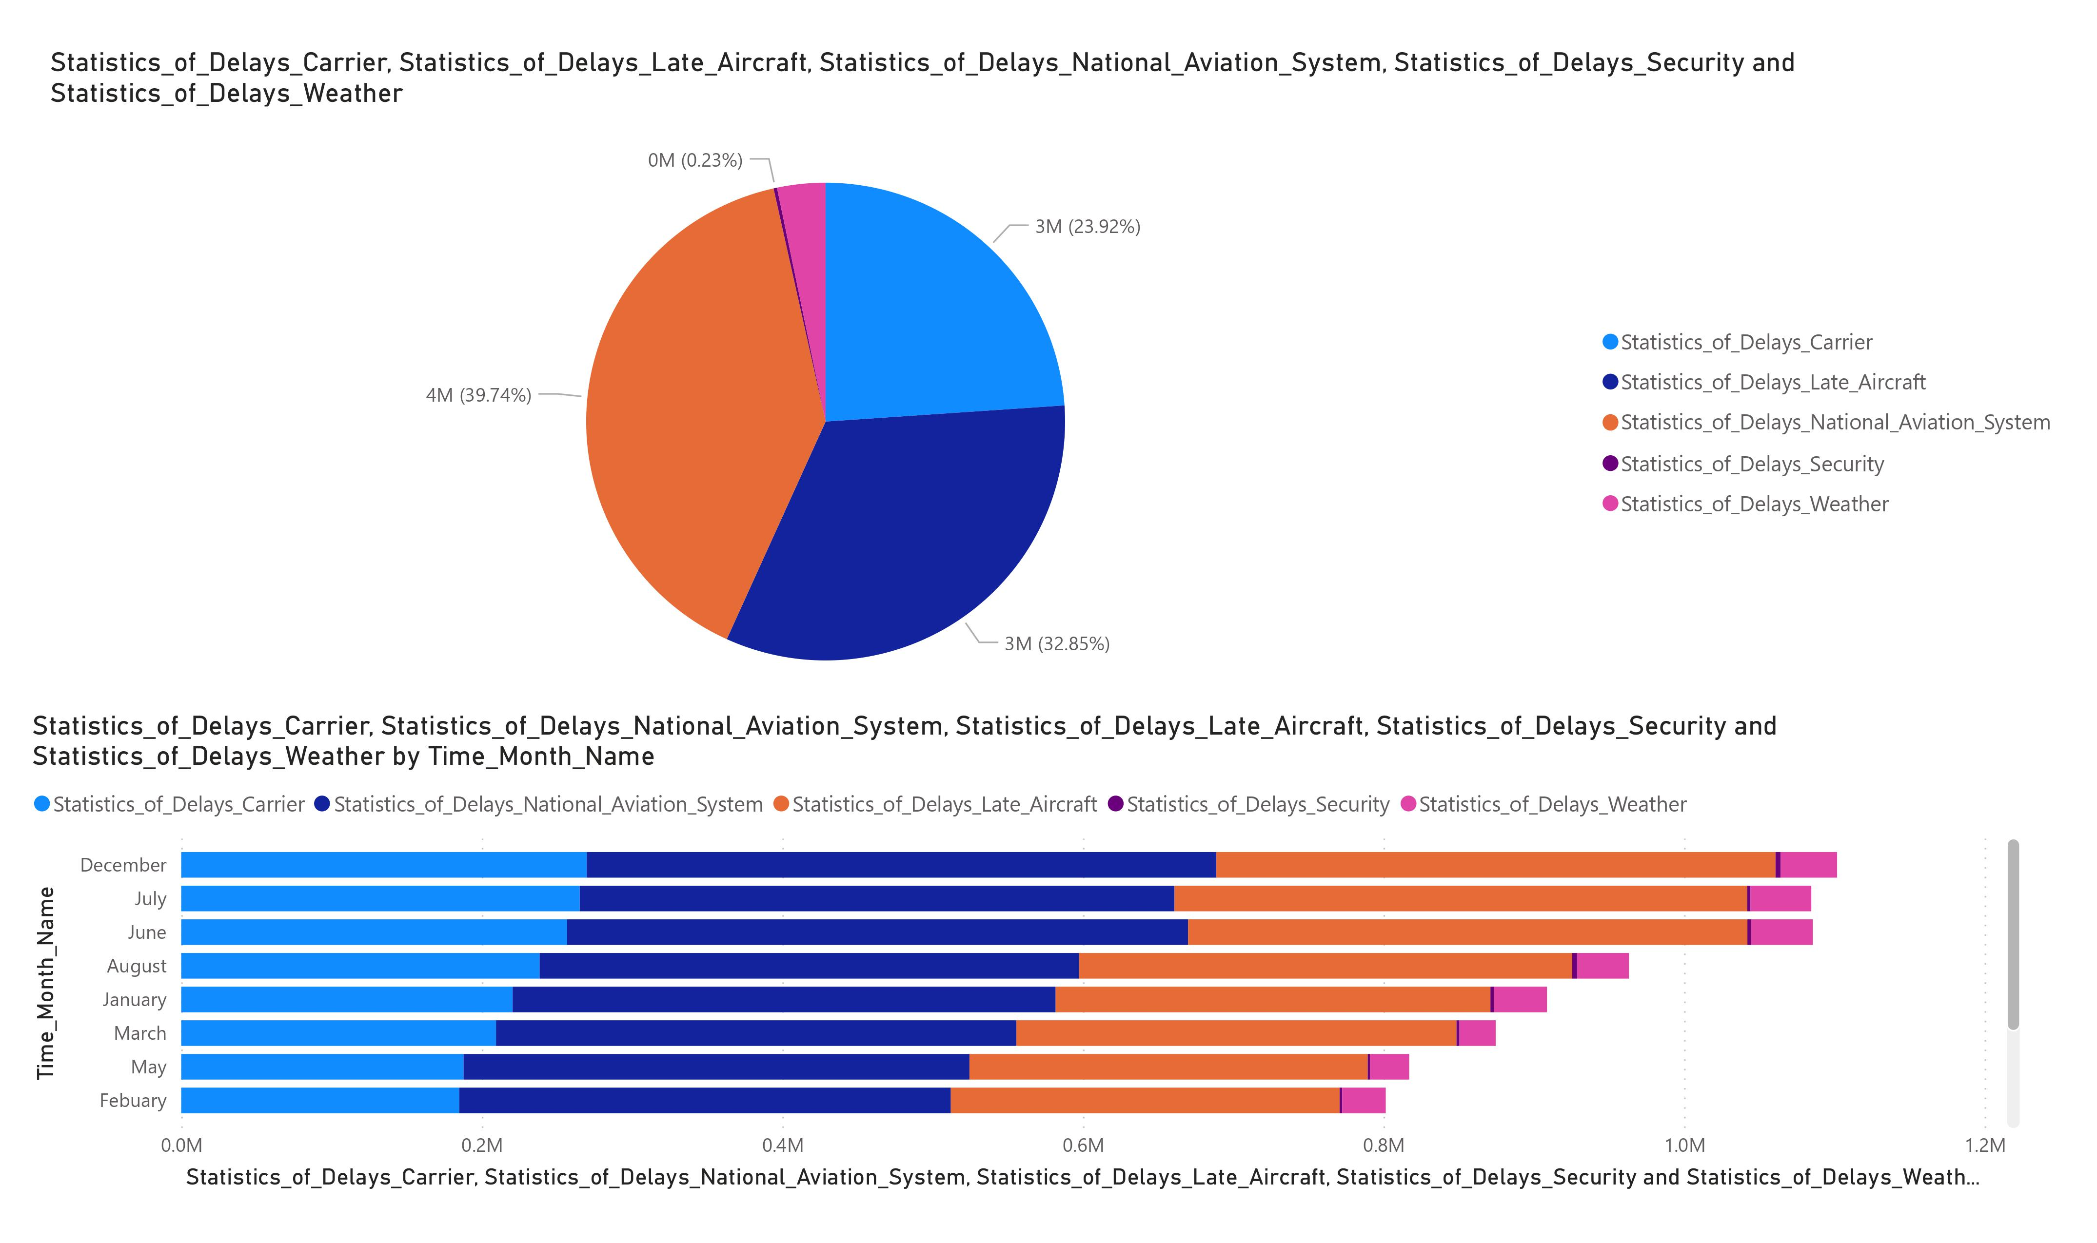
Visualization of delay delayed flight by reason of delay

Slide 34
Visualization of delayed and Cancelled flights by airport name

Slide 35
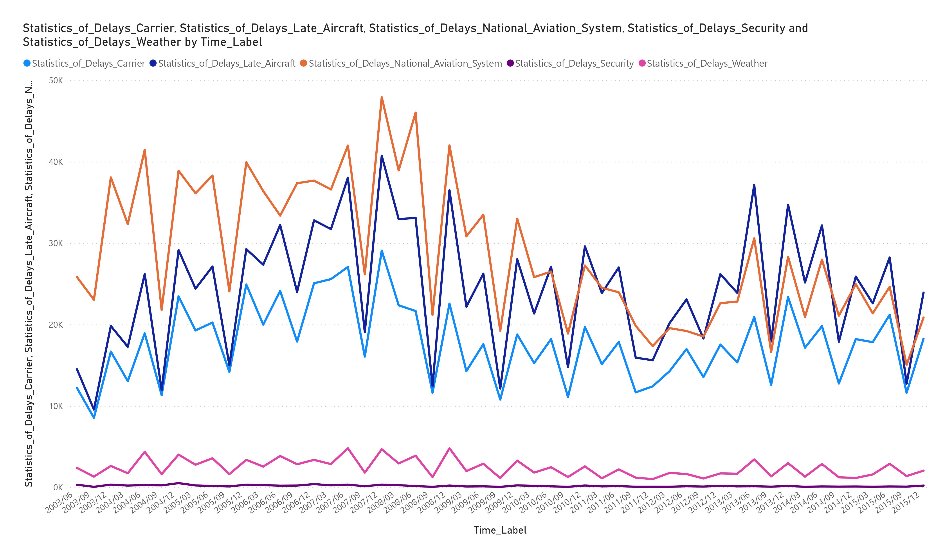
Visualization of no of flights delayed due to different reasons over the time

Slide 36
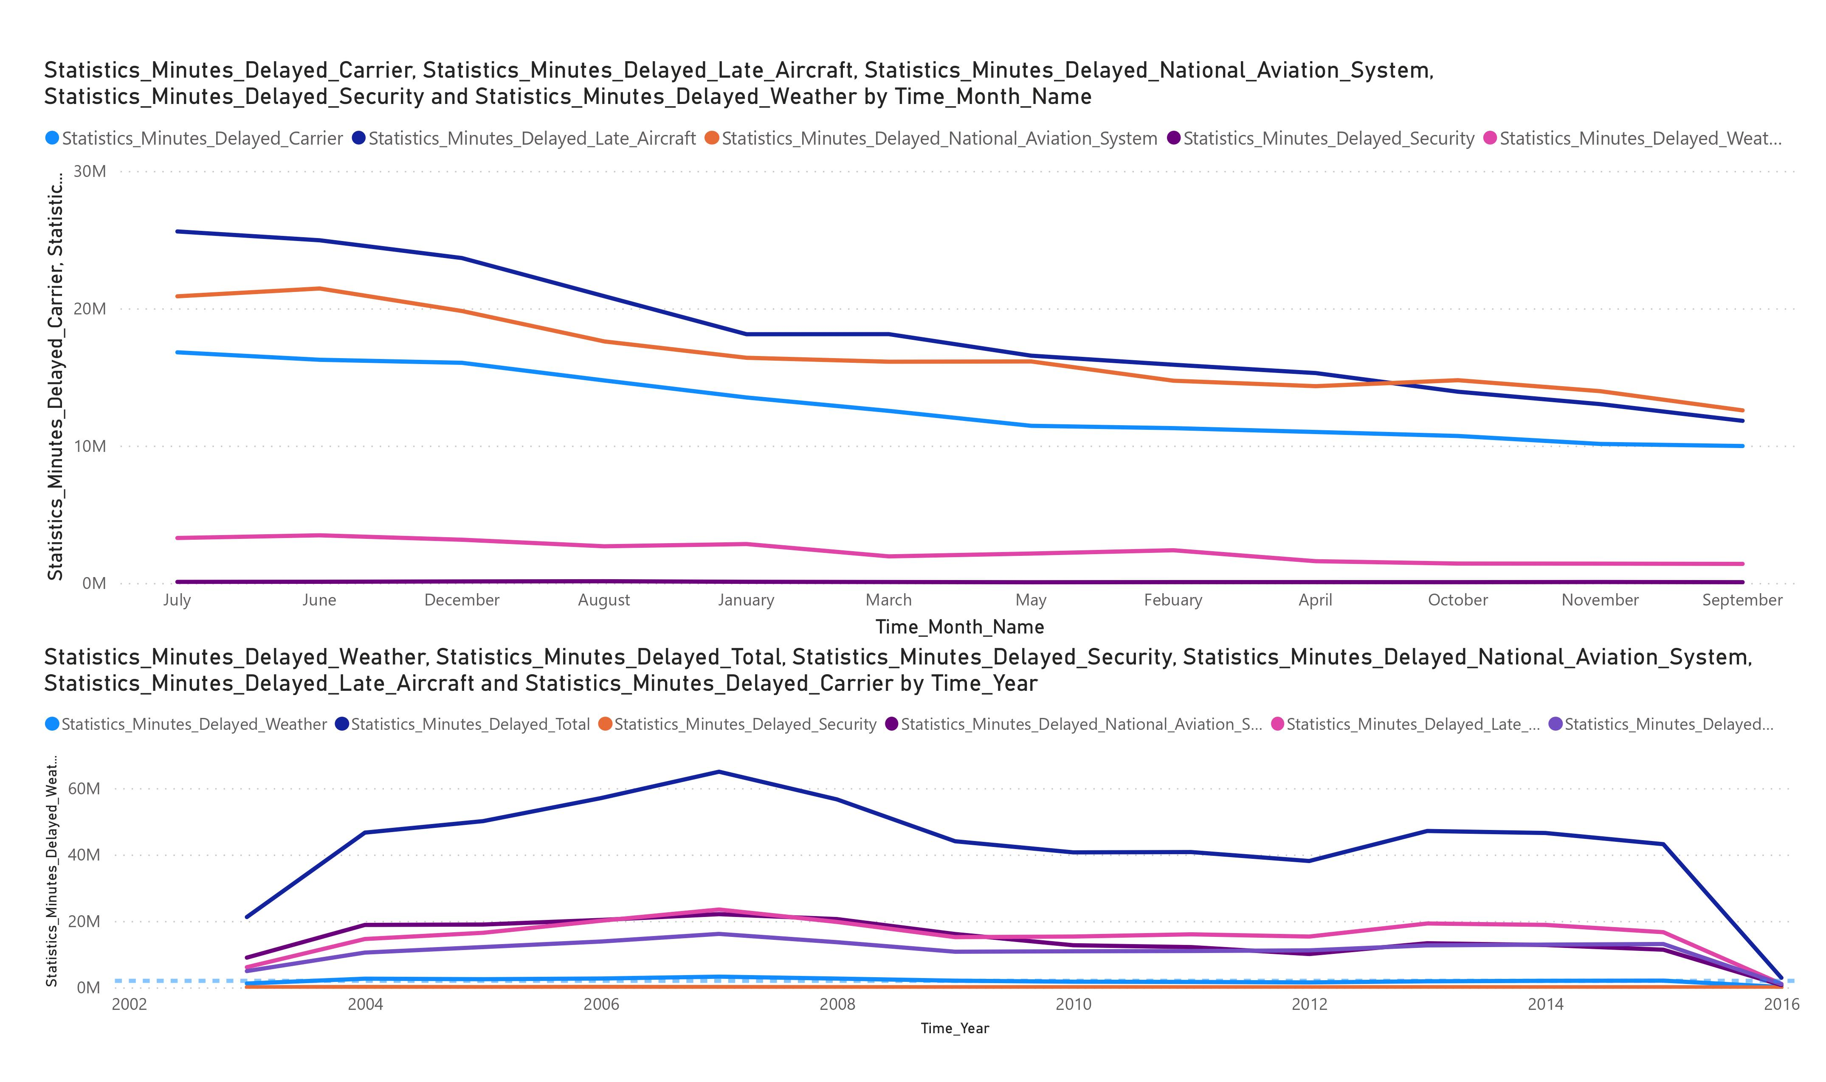
Visualization of Minutes delayed due to different reasons over the time

Slide 37

Summary
In the above project the visualization is done by importing the csv file to a blop storage then transformed the data using azure data factory and linked services . The Pipeline used to connect with SQL Database which has given the environment to visualize and get output in the form of structured table and visualizations through Power BI.

